Slide 1
Logistics & Distribution Network Performance Optimization

Slide 2
Contents
1
Business Problem
2
Business Objectives
3
Dataset Overview
4
Dataset Cleaning and Modelling
5
KPI & Measures
6
Executive Overview
7
Hub Analysis

Slide 3
Contents
8
Route Analysis
9
Cost Analysis
10
Key Insights
11
Recommendations
12
Business Impact

Slide 4

Business Problem Statement
A national logistics company managing multiple distribution hubs and delivery routes faced several operational challenges impacting service quality and profitability.
Key Challenges
Business Need
Increasing delivery delays and SLA breaches affecting customer satisfaction
Rising transportation and warehousing costs across operational hubs
Uneven hub performance and inefficient capacity utilization
Lack of centralized visibility into shipment cost and operational efficiency
Difficulty identifying high-cost routes and delivery bottlenecks
Management required an interactive Business Intelligence solution to:
monitor logistics operations centrally
track service-level performance
identify operational inefficiencies
improve decision-making through real-time analytics

Slide 5
Project Objectives
Improve on-time delivery performance and reduce SLA breaches
Reduce transportation and warehousing costs through operational analysis
Identify underperforming hubs and inefficient delivery routes
Improve customer service reliability through SLA compliance monitoring
Enable data-driven decision-making using interactive Power BI dashboards

Slide 6
Dataset Overview
Datasets Used:
Warehouse Hub Dataset
Shipments Dataset
Shipment Type Dataset
1
2
3
Contains operational information related to logistics hubs:
Hub location and region
Hub type and operational status
Capacity and throughput metrics
Hub operating costs
Warehouse size and storage infrastructure details
Daily shipment handling capacity analysis
Regional operational performance monitoring
Hub utilization and efficiency tracking
Main transactional dataset containing shipment-level information:
Shipment and delivery dates
Origin and destination cities
Distance traveled and transport mode
Fuel and operational costs
SLA status and customer details
Route-wise delivery performance analysis
Transportation efficiency and cost tracking
Shipment-level operational monitoring
Customer service and delivery compliance evaluation
Contains shipment category and cargo handling information:
Cargo classification and subcategory
Handling costs
Risk level and temperature requirements
SLA delivery duration
Cargo-specific operational analysis
Shipment handling and processing evaluation
Specialized logistics requirement monitoring
Delivery standard and compliance tracking

Slide 7
Data Preparation & Modeling
Datasets Used:
Data Cleaning & Transformation
Data Modeling
Calendar Table
1
2
3
Removed approximately 200 blank records from the Shipments dataset to improve data quality
Converted Shipment Date and Delivery Date columns using locale settings:
English (United Kingdom)
to ensure correct date interpretation and consistency
Verified and standardized data types across all datasets
Created separate dimension tables for Hub and Shipment Type datasets to support star schema modeling
Used the Shipments table as the central fact table
Established relationships between:
Shipments and Warehouse Hub datasets
Shipments and Shipment Type datasets
Calendar table and Shipment dates
Implemented a star schema data model for scalable and optimized analytics
Created a dedicated Calendar table for time-based analysis
Marked the Calendar table as the official Date Table in Power BI
Validation Included:
Unique dates
Continuous date range
No duplicate values
Valid date datatype
This enabled accurate:
SLA trend analysis
monthly performance tracking
time intelligence calculations

Slide 8
Dashboard KPIs & Metrics
1
On-Time Delivery %
Measures the percentage of shipments delivered within the committed SLA timeline.
2
Tracks the number of shipments that exceeded SLA delivery commitments.
SLA Breach Count
3
Represents the total operational transportation cost incurred across shipments.
Total Logistics Cost
4
Calculates the average operational cost incurred per shipment.
Cost per Shipment
5
Average Delivery Time
Measures the average number of days taken for shipment delivery.
6
Cost Efficiency Index
Represents operational cost incurred per kilometer traveled.

Slide 9
Dashboard KPIs & Metrics
7
Capacity Utilization %
Measures how efficiently logistics hubs are utilizing their shipment handling capacity.
8
Tracks the total shipment volume processed across the logistics network.
Total Shipments
9
Measures the total time taken between shipment dispatch and delivery completion for operational efficiency analysis.
Delivery Days
10
Tracks the average logistics expenditure incurred for each shipment processed across the network.
Average Shipment Cost
11
Represents the transportation fuel expenses associated with shipment movement and delivery operations.
Fuel Cost
12
Measures the operational expenditure incurred by logistics hubs for managing shipment processing and warehousing activities.
Hub Operating Cost

Slide 10
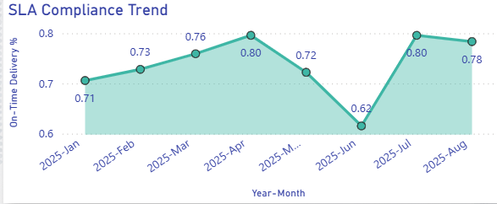
Executive Dashboard Overview
SLA Compliance Trend
Key Insight
SLA compliance showed fluctuations across the operational timeline, indicating inconsistent delivery performance during certain periods.
Why This Insight Is Important
SLA compliance directly impacts customer satisfaction and service reliability.
Identifying periods with lower compliance helps management investigate operational inefficiencies and delivery bottlenecks.
Reason Behind the Insight
Variations in shipment volume, route complexity, transportation delays, and operational workload may have contributed to fluctuations in SLA performance.
High shipment demand periods can increase delivery pressure on logistics hubs and transportation networks.

Slide 11
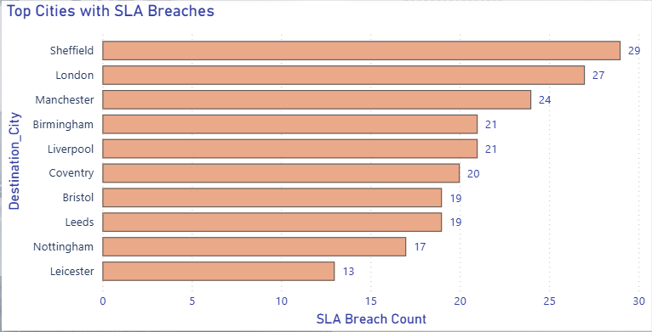
Executive Dashboard Overview
Top Cities with SLA Breaches
Key Insight
Certain cities consistently recorded higher SLA breaches, indicating route-specific or region-specific delivery challenges.
Why This Insight Is Important
Identifying high-delay locations helps management prioritize operational improvements and optimize delivery planning.
Enables focused monitoring of problematic delivery regions.
Reason Behind the Insight
Longer delivery distances, regional transportation constraints, high shipment volumes, and hub operational inefficiencies may contribute to higher SLA breaches in these cities.
Limited transportation flexibility or increased route congestion can also affect delivery timelines.

Slide 12
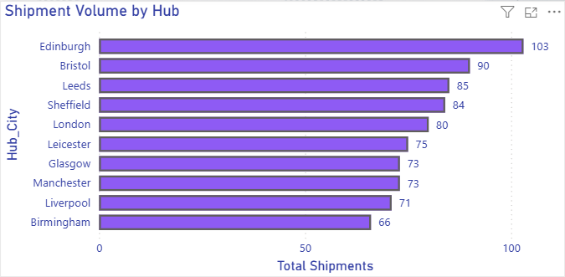
Hub Performance Analysis
Shipment Volume by Hub
Key Insight
Certain hubs handled significantly higher shipment volumes, indicating their importance as primary operational distribution centers.
Why This Insight Is Important
High-volume hubs play a major role in maintaining delivery continuity and shipment flow efficiency.
Monitoring shipment distribution helps management balance operational workload across the logistics network.
Reason Behind the Insight
Strategic hub locations, larger infrastructure capacity, and better transportation connectivity may contribute to increased shipment processing activity.
Central hubs often support multiple delivery routes and regions simultaneously.

Slide 13
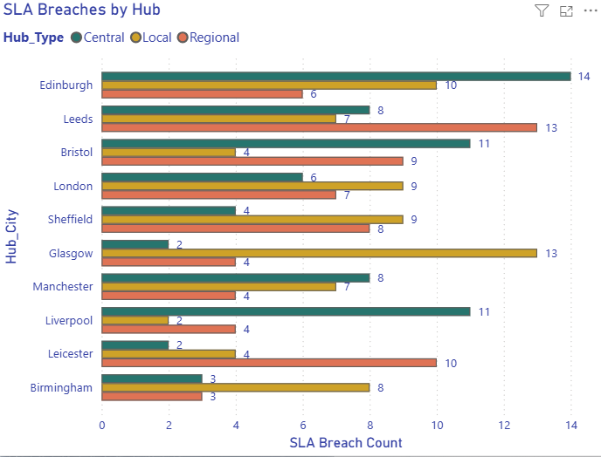
Hub Performance Analysis
SLA Breaches by Hub
Key Insight
Certain hubs contributed disproportionately to delivery delays and SLA breaches, indicating operational inefficiencies or higher delivery pressure.
Why This Insight Is Important
Identifying delay-prone hubs enables management to improve operational planning and resource allocation.
Helps prioritize corrective actions in critical operational locations.
Reason Behind the Insight
High shipment volumes, operational workload imbalance, transportation delays, and resource limitations may contribute to increased SLA breaches.
Hubs supporting long-distance or high-frequency delivery routes may experience greater delivery pressure.

Slide 14
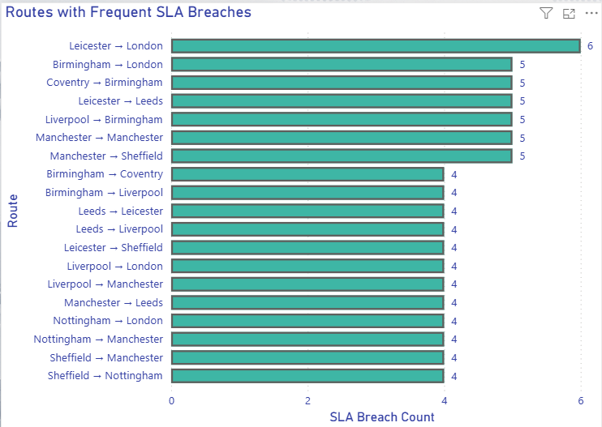
Route & Delivery Efficiency Analysis
Routes with Frequent SLA Breaches
Key Insight
Certain delivery routes consistently recorded higher SLA breaches, indicating operational bottlenecks and inefficient transportation corridors.
Why This Insight Is Important
Identifying delay-prone routes enables management to optimize delivery planning and improve transportation efficiency.
Helps reduce customer dissatisfaction caused by delayed deliveries.
Reason Behind the Insight
Long travel distances, transportation congestion, route complexity, and higher shipment frequency may contribute to increased delivery delays on specific routes.
Limited transport flexibility and operational dependency on certain corridors can also affect SLA performance.

Slide 15
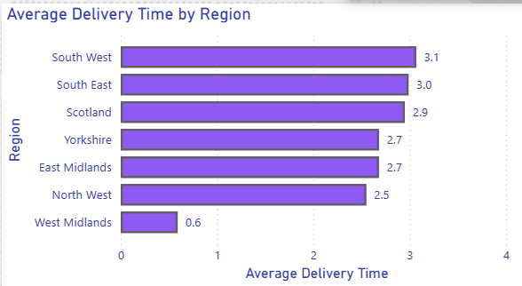
Route & Delivery Efficiency Analysis
Average Delivery Time by Region
Key Insight
Delivery performance varied across regions, with some regions recording longer average delivery timelines.
Why This Insight Is Important
Regional delivery analysis helps management identify areas requiring operational improvement and route optimization.
Supports better logistics planning and transportation efficiency monitoring.
Reason Behind the Insight
Differences in transportation infrastructure, shipment distance, regional demand, and route complexity may influence delivery duration across regions.
High shipment concentration in certain regions can also increase operational pressure and delivery time.

Slide 16
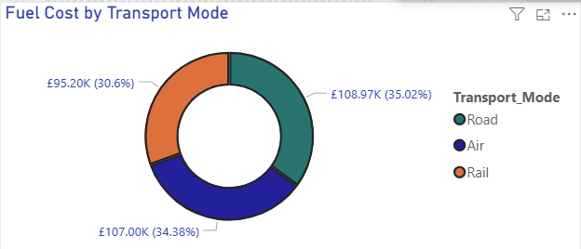
Cost & Profitability Analysis
Fuel Cost by Transport Mode
Key Insight
Certain transport modes contributed disproportionately to overall fuel expenditure, indicating differences in transportation efficiency.
Why This Insight Is Important
Fuel cost is a major operational expense in logistics operations.
Monitoring transport-wise fuel spending helps management identify cost optimization opportunities and improve transportation planning.
Reason Behind the Insight
Differences in transportation distance, shipment volume, fuel consumption patterns, and transport infrastructure may influence fuel expenditure across transport modes.
Air and road transportation generally involve higher fuel-related operational costs compared to rail-based movement.

Slide 17
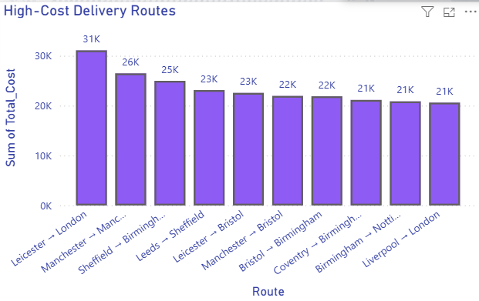
Cost & Profitability Analysis
High-Cost Delivery Routes
Key Insight
Certain delivery routes consistently incurred significantly higher operational costs compared to other shipment corridors.
Why This Insight Is Important
High-cost routes directly impact logistics profitability and operational efficiency.
Identifying expensive transportation corridors helps management optimize route planning and reduce operational expenditure.
Reason Behind the Insight
Longer shipment distances, higher fuel consumption, transportation complexity, and shipment handling requirements may contribute to increased operational costs.
Routes requiring frequent long-distance transportation or specialized cargo handling can also increase logistics spending.

Slide 18
Key Findings & Insights
Delivery & SLA Performance
Hub Operations
Transportation & Cost Efficiency
Business Intelligence Impact
SLA breaches were concentrated in specific delivery routes and operational hubs.
Longer shipment distances showed a higher tendency for delayed deliveries.
Delivery performance varied significantly across regions and transport modes.
Certain hubs processed substantially higher shipment volumes, indicating uneven operational workload distribution.
Capacity utilization remained high in major hubs, highlighting infrastructure dependency on key operational centers.
Hub operating costs differed considerably across locations.
Transportation costs increased with shipment distance and transport complexity.
Fuel cost contribution was higher for road and air transport operations. Some delivery routes consistently showed higher operational costs per shipment.
Centralized dashboards improved visibility into logistics operations and KPI monitoring.
Interactive analytics enabled faster identification of operational bottlenecks and cost drivers.
Real-time performance tracking supported data-driven operational decision-making.

Slide 19
Recommendations
Improve Route Optimization
Re-evaluate high SLA breach routes to reduce delivery delays and transportation inefficiencies.
Optimize long-distance shipment planning using suitable transport modes.
Enhance Hub Performance
Balance shipment workload across hubs to reduce operational pressure on high-volume locations.
Improve resource allocation and throughput management for underperforming hubs.
Reduce Operational Costs
Monitor fuel-intensive transport operations and improve transportation efficiency.
Optimize high-cost delivery routes through better route planning and shipment consolidation.
Strengthen SLA Compliance
Implement proactive monitoring for delay-prone routes and hubs.
Use real-time KPI tracking for faster operational response and issue resolution.
Improve Decision-Making
Utilize centralized Power BI dashboards for continuous operational monitoring.
Enable management teams to make data-driven logistics and capacity planning decisions.

Slide 20
Business Impact
Improved Delivery Monitoring
Enabled centralized tracking of SLA compliance and delivery performance.
Improved visibility into delay-prone routes and operational bottlenecks.
Enhanced Operational Efficiency
Supported hub-level performance monitoring and capacity utilization analysis.
Enabled identification of inefficient transportation and shipment routes.
Better Cost Management
Improved visibility into transportation, fuel, and handling costs.
Enabled monitoring of high-cost routes and shipment operations.
Data-Driven Decision Making
Provided interactive KPI dashboards for operational and strategic analysis.
Improved business reporting through centralized Power BI analytics.
Scalable Analytics Framework
Implemented a structured star schema data model for scalable reporting.
Enabled future expansion for predictive logistics and advanced analytics integration.

Slide 21
THANK YOU

Slide 22
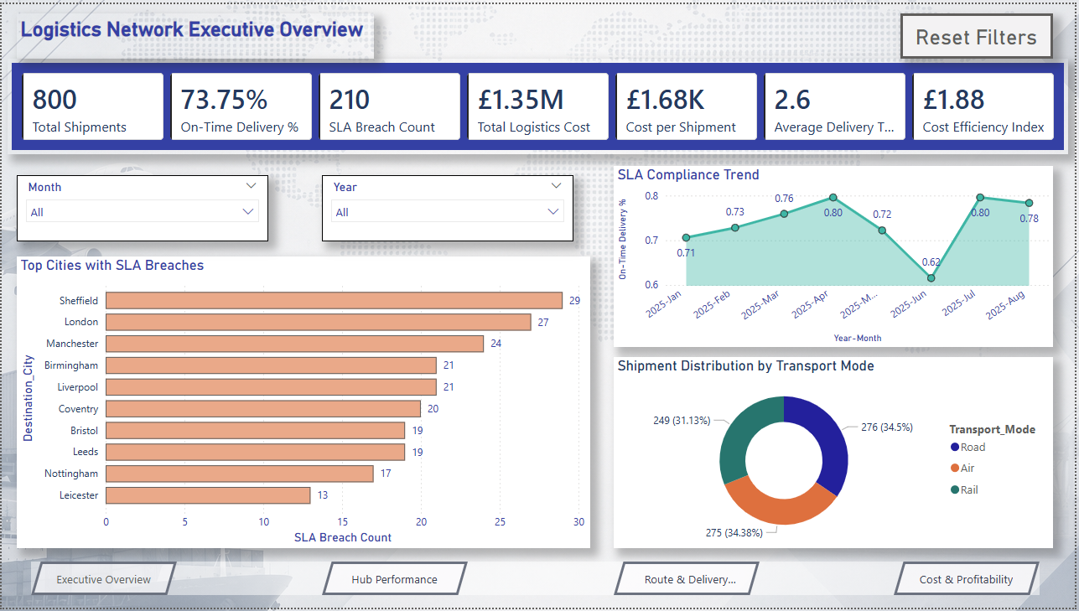
Executive Dashboard Overview
Key Dashboard Features
Interactive KPI monitoring
SLA compliance trend analysis
Transport mode distribution analysis
City-wise SLA breach monitoring
Dynamic filtering and drill-down capability
Navigation across multiple analytical pages
Reset filter functionality for improved user interaction
Dashboard Benefits
Improved visibility into logistics operations
Faster identification of operational bottlenecks
Enhanced decision-making through centralized analytics
Better monitoring of delivery performance and service reliability

Slide 23
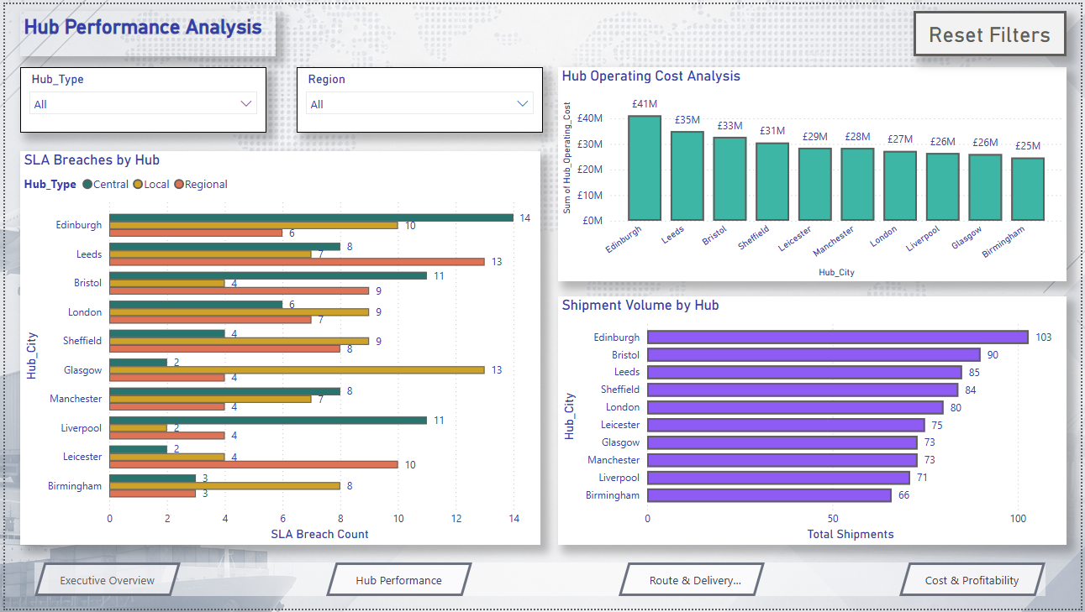
Hub Performance Analysis
Key Insights
Edinburgh processed the highest shipment volume among all hubs, indicating its role as a major operational center.
Certain hubs showed higher SLA breach counts, highlighting potential delivery bottlenecks and operational inefficiencies.
Hub operating costs varied significantly across locations, suggesting differences in operational scale and resource allocation.
Regional and central hubs contributed differently to shipment processing and SLA performance, enabling comparative operational analysis.
Business Value
The hub-level analysis enables management to:
improve hub efficiency
reduce operational delays
balance shipment workload across the network

Slide 24
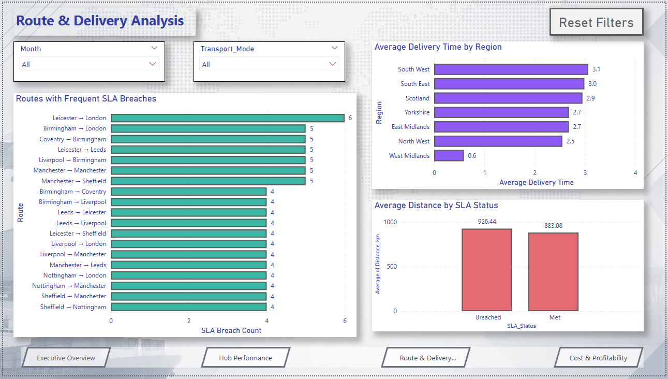
Route & Delivery Efficiency Analysis
Key Insights
Certain delivery routes consistently recorded higher SLA breaches, indicating operational bottlenecks in specific shipment corridors.
Average delivery time varied across regions, highlighting differences in route efficiency and transportation performance.
Distance-based operational analysis enabled identification of high-risk delivery routes requiring optimization.
Business Value
The route analysis enables management to:
improve delivery planning
optimize transportation routes
reduce SLA violations
improve customer delivery reliability
monitor route-wise operational efficiency

Slide 25
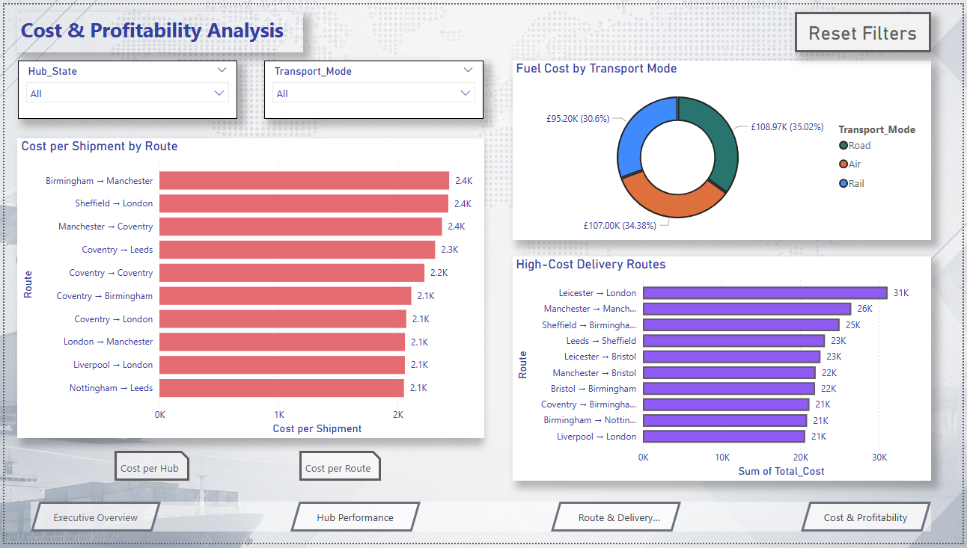
Cost & Profitability Analysis
Key Insights
Certain delivery routes incurred significantly higher operational costs, indicating inefficient transportation corridors and resource-intensive deliveries.
Fuel cost contribution varied across transport modes, with road and air transport showing higher operational expenditure.
Cost per shipment differed across hubs and routes, highlighting regional cost variations and operational inefficiencies.
Business Value
The cost analysis enables management to:
monitor operational expenditure
identify high-cost logistics routes
improve transportation efficiency
optimize shipment planning
support profitability-focused decision-making

